Slide 1
Loamy and Clayey Hydric Soil Field Indicators
Fine Textured Indicators
Field Indicators of Hydric Soils, v. 8.2, 2018
Lisl Townsend
SJRWMD Soil Scientist
March 21, 2021

Slide 2
Loamy and Clayey Soils Notes
Field Indicators of Hydric Soils states on page 21:
All mineral layers above any of the layers meeting the requirements of any F-indicator(s) have a dominant chroma of 2 or less, or the thickness of the layer(s) with a dominant chroma of more than 2 is less than 15 cm (6 inches).
WHAT DOES THIS MEAN?
Basically, above the indicator’s starting depth either:
There are no mineral soil layers
All mineral soil above the starting depth has a dominant chroma of 2 or less
There are less than 6 inches of mineral soil material with a dominant chroma of more than 2 above the starting depth
*Except for F8, F12, F19, F20, F21
Except for F16, nodules and concretions are not considered redox concentrations.

Slide 3
F2 – Loamy Gleyed Matrix
Is there a layer(s) of loamy very fine sand or finer soil texture in which 60% or more of the layer is a gleyed matrix
Does the layer(s) start < 12 inches from the soil surface
Above the starting depth of this indicator, is either Option A, B, or C satisfied:
There are no mineral soil layers above this indicator
All mineral soil above this indicator has a dominant chroma of 2 or less
There are less than 6 inches of mineral soil material with a dominant chroma of more than 2 above this indicator

Slide 4
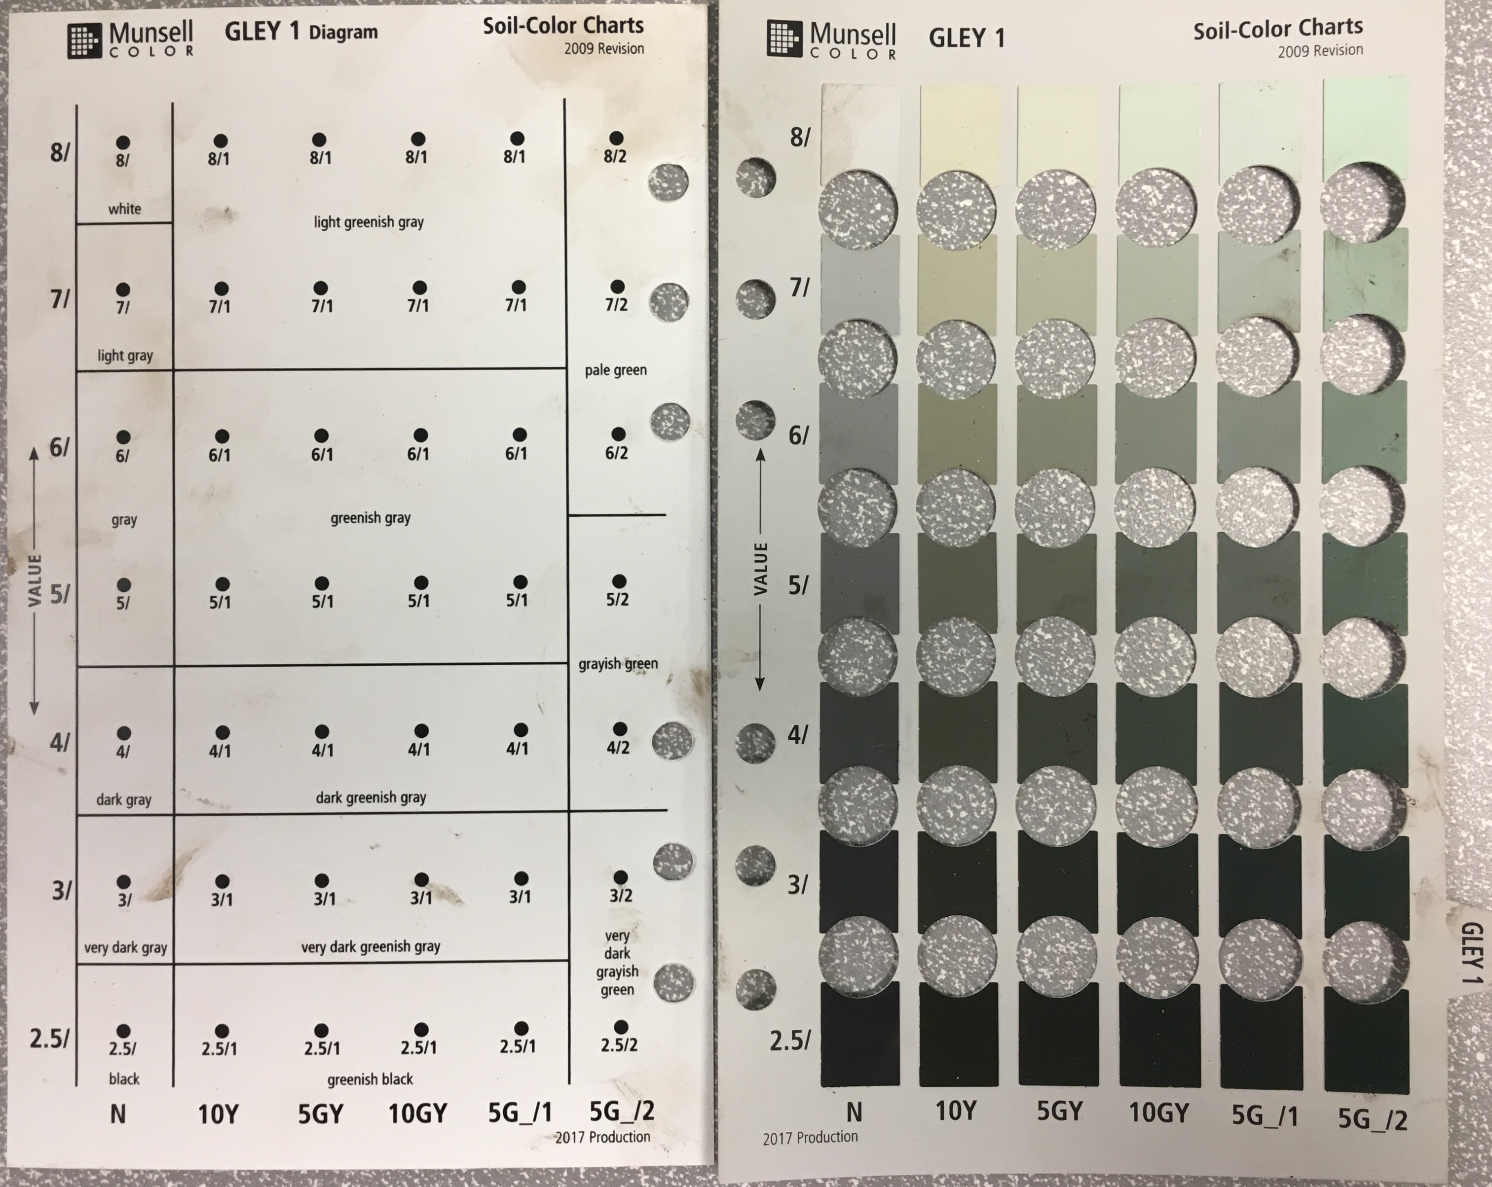
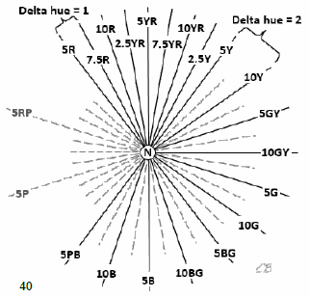
Gleyed Matrix
DEP Data Form Guide
Above this line are gleyed matrix colors
Hues on the Gley 1 page

Slide 5
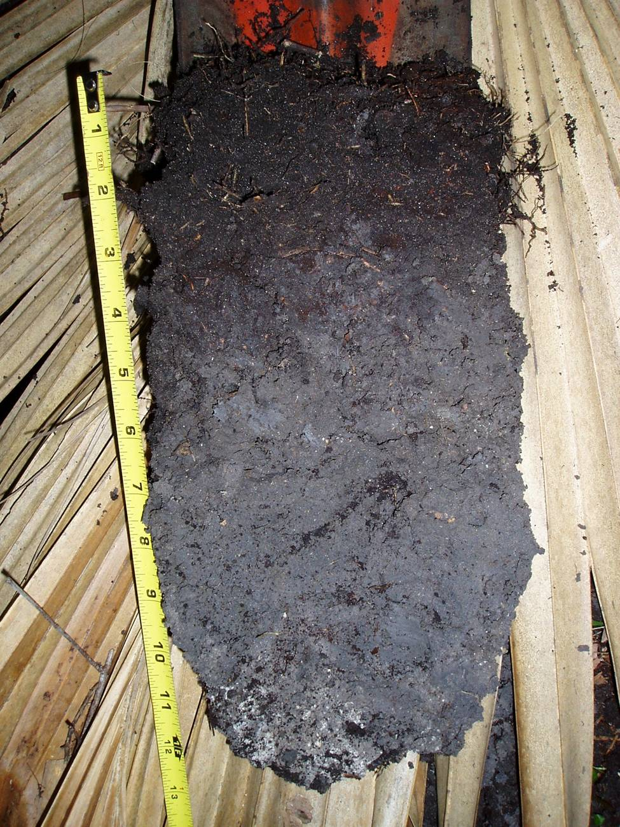
F2 – Loamy Gleyed Matrix
Fine Mucky Mineral
10YR 2/1 (black)
0 – 3 inches
Sandy Clay Loam
N 4/ (dark gray)
3 – 13 inches
DEP Photo

Slide 6
F3 – Depleted Matrix
Is there a layer(s) of loamy very fine sand or finer soil texture with a depleted matrix
Does the layer(s)’s matrix have 60% or more chroma of 2 or less
Does the layer(s) satisfy either Option A or B
Layer(s) is 2 inches or more thick
AND
Starts < 4 inches from the soil surface
Layer(s) is 6 inches or more thick
AND
Starts < 10 inches from the soil surface
Above the starting depth of this indicator, is either Option A, B, or C satisfied:
There are no mineral soil layers above this indicator
All mineral soil above this indicator has a dominant chroma of 2 or less
There are less than 6 inches of mineral soil material with a dominant chroma of more than 2 above this indicator

Slide 7
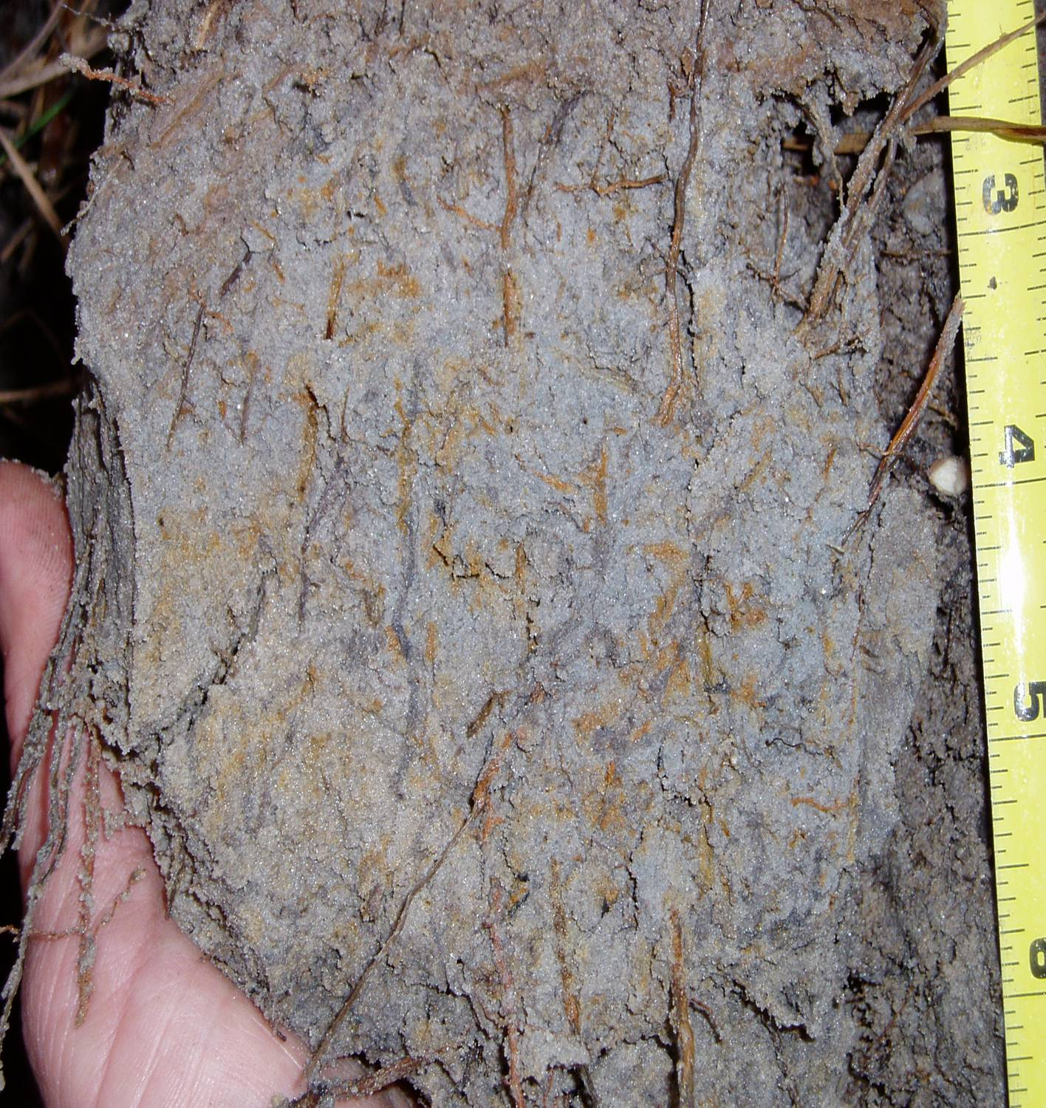
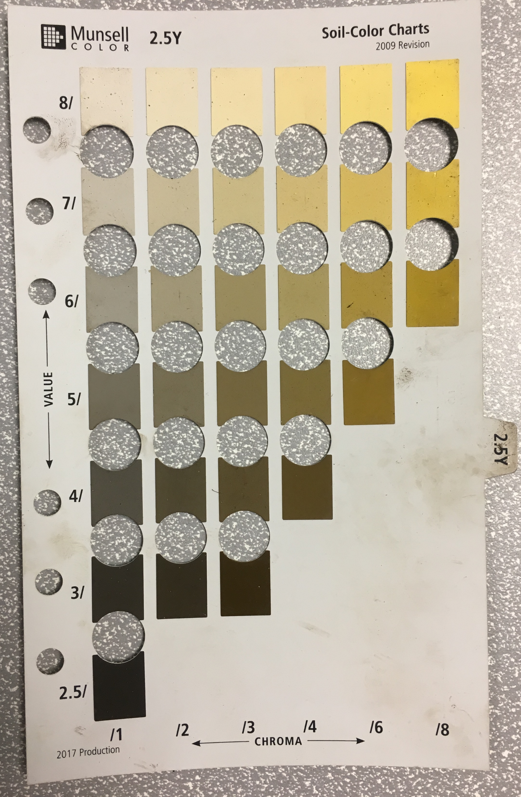
F3 – Depleted Matrix
Matrix value of 5 or more and chroma of 1 or less or matrix value of 6 or more and chroma of 2 or less
THEN
Does not require 2% or more redox concentrations occurring as soft masses or pore linings
*Not an A, E, or calcic horizons
Matrix value of 5 and chroma of 2 or matrix value of 4 and chroma of 2 or less
OR
A, E, or Calcic horizons
THEN
Requires 2% or more redox concentrations occurring as soft masses or pore linings:

Slide 8
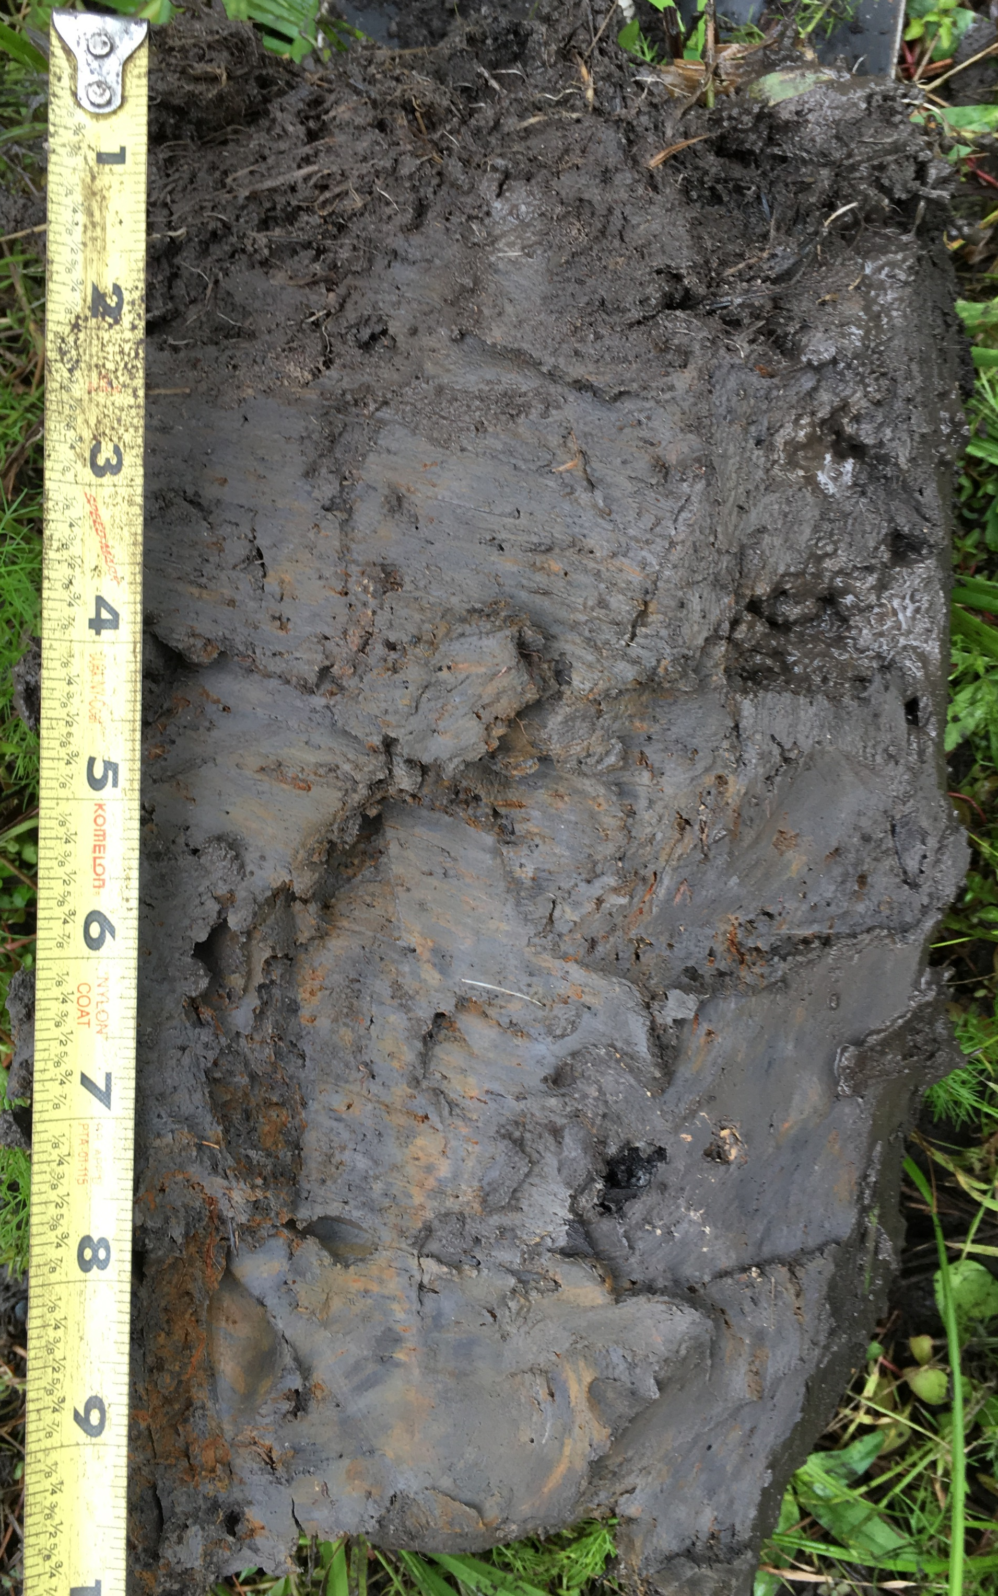
F3 – Depleted Matrix
Sandy Clay Loam
N 3/ (very dark gray)
0 – 1.5 inches
Sandy Clay Loam
10YR 4/1 (dark gray)
Redox concentrations: 25%, 10YR 5/6, diffuse, round
1.5 – 9.75 inches

Slide 9
F6 – Redox Dark Surface
Is there a layer(s) of loamy very fine sand or finer or fine mucky mineral soil texture with distinct or prominent redox concentrations occurring as soft masses and/or pore linings
Does the layer(s) with redox concentrations satisfy either Option A or B
Layer(s)’s matrix has value of 3 or less and chroma of 1 or less
AND
Has 2% or more redox concentrations
Layer(s)’s matrix has value of 3 or less and chroma of 2 or less
AND
Has 5% or more redox concentrations
Is the layer(s) 4 inches or more thick
Does the layer(s) start < 8 inches from the soil surface
Above the starting depth of this indicator, is either Option A, B, or C satisfied:
There are no mineral soil layers above this indicator
All mineral soil above this indicator has a dominant chroma of 2 or less
There are less than 6 inches of mineral soil material with a dominant chroma of more than 2 above this indicator

Slide 10
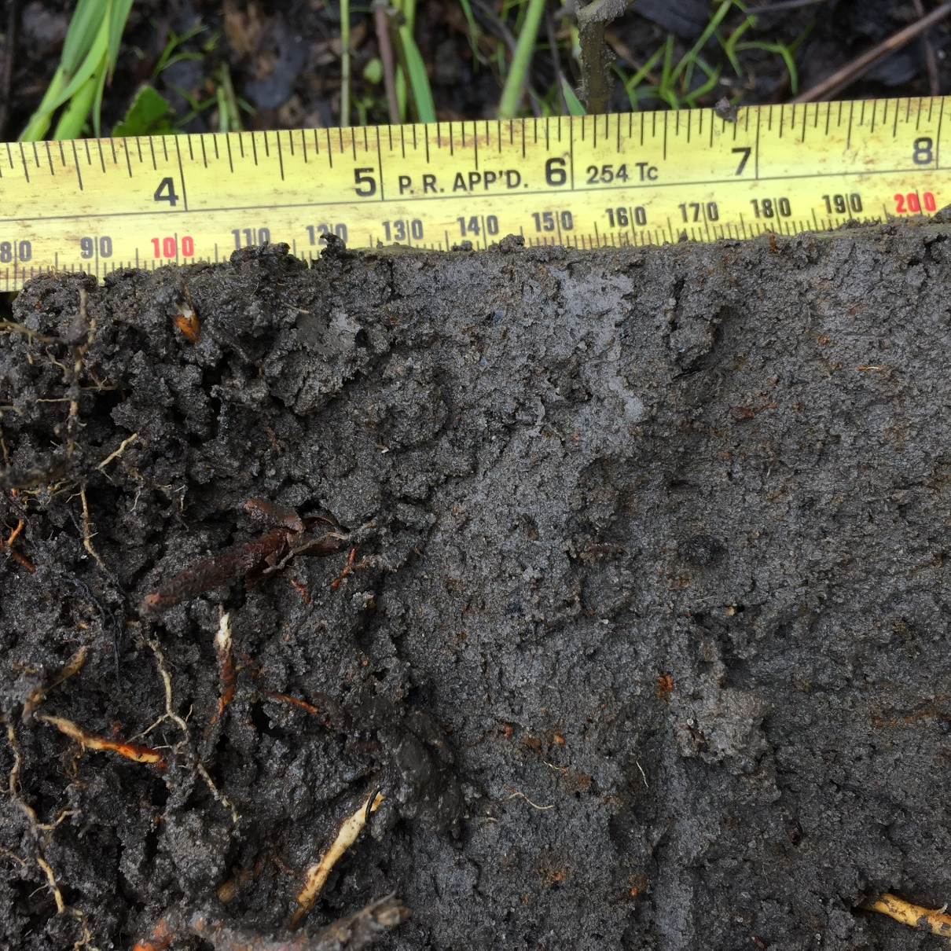
F6 – Redox Dark Surface
Sandy Clay Loam
10YR 3/1 (dark gray)
Redox concentrations: 20%, 10YR 5/6, diffuse, round
2.5 – 8 inches
Redox Concentrations

Slide 11
F7 – Depleted Dark Surface
Is there a layer(s) of loamy very fine sand or finer or fine mucky mineral soil texture with redox depletions (lighter areas associated with redox concentrations)
Do the redox depletions have value of 5 or more and chroma of 2 or less
Does the layer(s) with redox depletions satisfy either Option A or B
Layer(s)’s matrix has value of 3 or less and chroma of 1 or less
AND
Has 10% or more redox depletions
Layer(s)’s matrix has value of 3 or less and chroma of 2 or less
AND
Has 20% or more redox depletions
Is the layer(s) 4 inches or more thick
Does the layer(s) start < 8 inches from the soil surface
Above the starting depth of this indicator, is either Option A, B, or C satisfied:
There are no mineral soil layers above this indicator
All mineral soil above this indicator has a dominant chroma of 2 or less
There are less than 6 inches of mineral soil material with a dominant chroma of more than 2 above this indicator

Slide 12
F7 – Depleted Below Dark Surface
Redox Depletions
Sandy Clay Loam
10YR 3/1 (dark gray)
Redox depletions: 30%, 10YR 5/1, diffuse, round
8 – 16 inches

Slide 13
F8 – Redox Depressions
Is the soil profile located within a closed depression subject to ponding
Is there a layer(s) of loamy very fine sand or finer or fine mucky mineral soil texture with 5% or more distinct or prominent redox concentrations occurring as soft masses and/or pore linings
Is the layer(s) 2 inches or more thick
Does the layer(s) start < 4 inches from the soil surface

Slide 14
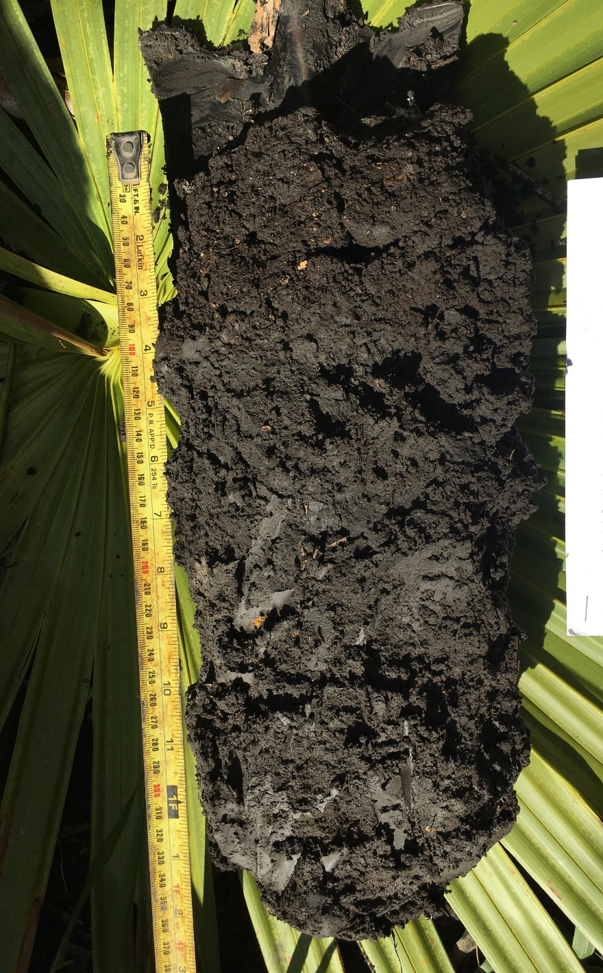
F8 – Redox Depressions
Sand
10YR 2/1 (black)
Fill material
0 – 4 inches
Redox Concentrations
Clay
N 2.5/ (black)
Redox concentrations: 15%, 10YR 6/8, diffuse, round
4 – 16 inches

Slide 15
F10 - Marl
Is the soil profile located with Land Resource Regions U
Is there a layer(s) of marl soil material
Does the layer(s) have value of 5 or more and chroma of 2 or less
Does the layer(s) start < 4 inches from the soil surface

Slide 16
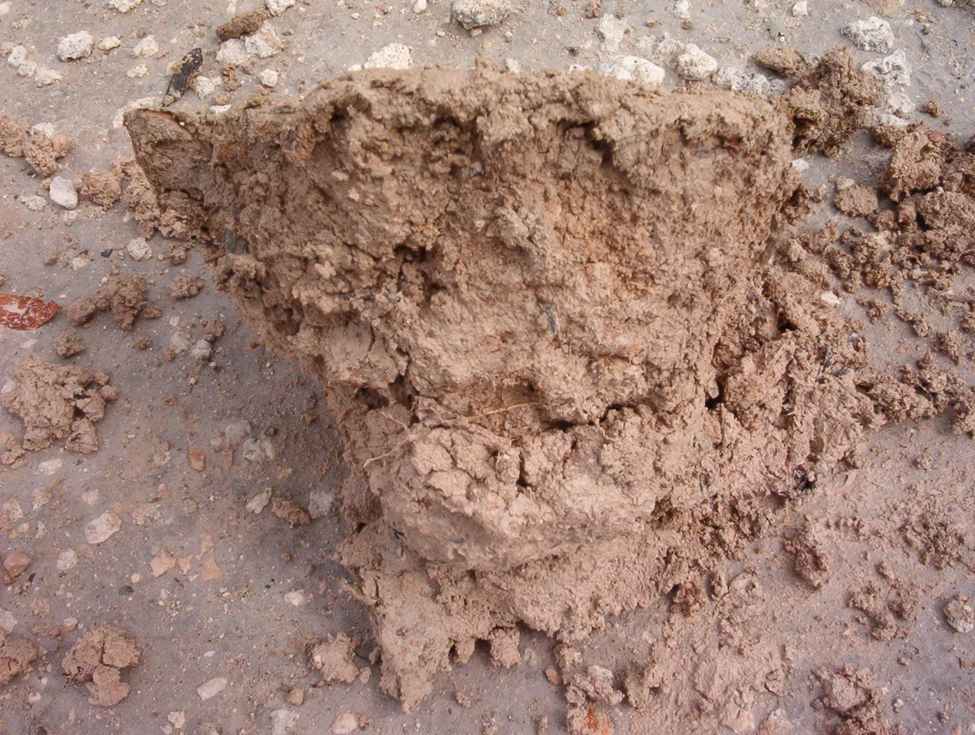
F10 – Marl
Marl: Calcium carbonate and various amounts of clays and silts
Common calcium carbonate found in marl is calcite.
Calcite forms sedimentary rocks like limestone and chalk.
Soil Taxonomy, 2014
DEP Photo

Slide 17
F13 – Umbric Surface
Is there a layer(s) of loamy very fine sand or finer or fine mucky mineral or muck soil texture
Is the layer(s) 10 inches or more thick
Does the layer(s) satisfy both Criteria 1 and 2
The upper 6 inches of the layer(s) has value of 3 or less and chroma of 1 or less
AND
The lower 4 inches of the layer(s) has chroma of 2 or less
Does the layer(s) start < 6 inches from the soil surface

Slide 18
F13 – Umbric Surface
Sand
10YR 2/1 (black)
Fill material
0 – 4 inches
Clay
N 2.5/ (black)
Redox concentrations: 15%, 10YR 6/8, diffuse, round
4 – 16 inches

Slide 19
THANK YOU

